Slide 1

The Cortana Intelligence Suite
Focus – Microsoft R for Architects
Microsoft Machine Learning and Data Science Team
CortanaIntelligence.com
Notes:
Main page -http://cortanaanalytics.com
To begin this module, you should have:
Basic Math and Stats skills
Business and Domain Awareness
General Computing Background
NOTE: These workbooks contain many resources to lead you through the course, and provide a rich set of references that you can use to learn much more about these topics. If the links do not resolve properly, type the link address in manually in your web browser. If the links have changed or been removed, simply enter the title of the link in a web search engine to find the new location or a corollary reference.

Slide 2
Welcome!
Log in to the site:
http://cisw-foundations.azurewebsites.net/
Select the “CISR302 - Microsoft R (Architecture and Administration)” Link
Notes:
Note to instructor: the lab that follows is for students that will be running this course locally. Since Visual Studio takes a very long time to run, you should start that lab (if the students are running locally) immediately.
If the students are going to use the Windows Data Science Virtual Machine then this lab is not needed.

Slide 3



Lab:
Optional: Local Workstation Setup
Notes:
Optional, if using your local machine:
All binaries are available here - https://learnanalyticsassets.blob.core.windows.net/mrs/rclass.zip
Install SQL Server 2016 and ensure you select R Services
Install Visual Studio Community Edition 2015 (This will take quite some time), ensure you select SQL Server Data Tools
Install R Tools for Visual Studio
Also optional – instead of SQL Server 2016 and Visual Studio 2015, you can use SQL Server 2017 Developer Edition if you select “SQL Server ML Services”, and Visual Studio 2017 Community Edition, if you install the “Data Science” workload.

Slide 4

Learning Objectives
Understand the R Language and where it is used
Understand the Microsoft R Platform and its capabilities
Set up and use the server and various client tools for a R environment
Know how to operationalize a SQL Server R Services environment
Use the Microsoft R capabilities in a solution
Notes:
At the end of this Course, you will:
Understand the R Language and where it is used
Understand the Microsoft R Platform and its capabilities
Set up and use the server and various client tools for a R environment
Know how to operationalize a SQL Server R Services environment
Use the Microsoft R capabilities in a solution

Slide 5
The Data Science Process and Platform
Notes:
This process largely follows the CRISP-DM model - http://www.sv-europe.com/crisp-dm-methodology/

Slide 6
The Team Data Science Process
Business Understanding
Define Objectives
Identify Data Sources
Data Acquisition and Understanding
Ingest Data
Explore Data
Modeling
Feature Selection
Create and Train Model
Deployment
Customer Acceptance
Operationalize
Testing and Validation
Update Data
Handoff
Re-train and re-score
Notes:
It also references the Cortana Intelligence process - https://azure.microsoft.com/en-us/documentation/articles/data-science-process-overview/
A complete process diagram is here - https://azure.microsoft.com/en-us/documentation/learning-paths/cortana-analytics-process/
Some walkthrough’s of the various services - https://azure.microsoft.com/en-us/documentation/articles/data-science-process-walkthroughs/
An integrated process and toolset allows for a more close-to-intent deployment
Iterations are required to close in on the solution – but are harder to manage and monitor
Data Science Blog - https://buckwoody.wordpress.com/

Slide 7
The Cortana Intelligence Platform
Big Data
Intelligence and Advanced Analytics
Information Management
Solutions
Visualization
Data Catalog
Data Factory
Event Hubs
Data Lake
SQL Data Warehouse
Cosmos DB
Cortana, Bot Service, Cognitive Framework
HDInsight
Data Lake
Azure Storage
Stream Analytics
Analysis Services
Power BI
R
Templates and Gallery
Machine Learning
Notes:
Azure Data Catalog - http://azure.microsoft.com/en-us/services/data-catalog (Doc It)
Azure Data Factory - http://azure.microsoft.com/en-us/services/data-factory/ (Move It)
Azure Event Hubs - http://azure.microsoft.com/en-us/services/event-hubs/ (Bring It)
Platform and Storage - Microsoft Azure – http://microsoftazure.com Storage - https://azure.microsoft.com/en-us/documentation/services/storage/ (Host It)
Azure Data Lake - http://azure.microsoft.com/en-us/campaigns/data-lake/ (Store It)
Azure SQL Data Warehouse - http://azure.microsoft.com/en-us/services/sql-data-warehouse/ (Relate It)
Azure Cosmos DB - https://docs.microsoft.com/en-us/azure/cosmos-db/introduction
Cortana - http://blogs.windows.com/buildingapps/2014/09/23/cortana-integration-and-speech-recognition-new-code-samples/ and https://blogs.windows.com/buildingapps/2015/08/25/using-cortana-to-interact-with-your-customers-10-by-10/ and https://developer.microsoft.com/en-us/Cortana (Say It)
Cognitive Services - https://www.microsoft.com/cognitive-services
Bot Framework - https://dev.botframework.com/
Azure Machine Learning - http://azure.microsoft.com/en-us/services/machine-learning/ (Learn It)
Azure HDInsight - http://azure.microsoft.com/en-us/services/hdinsight/ (Scale It)
Azure Stream Analytics - http://azure.microsoft.com/en-us/services/stream-analytics/ (Stream It)
Analysis Services - https://docs.microsoft.com/en-us/azure/analysis-services/analysis-services-overview
Power BI - https://powerbi.microsoft.com/ (See It)
All of the components within the suite - https://www.microsoft.com/en-us/server-cloud/cortana-intelligence-suite/what-is-cortana-intelligence.aspx
Templates - https://gallery.cortanaintelligence.com/browse?orderby=freshness%20desc&skip=0&categories=%5B%2210%22%5D and https://caqs.azure.net/#gallery

Slide 8
DevOps for Data Science
Notes:
Complete DevOps guide - https://docsmsftpdfs.blob.core.windows.net/guides/azure/azure-ops-guide.pdf

Slide 9
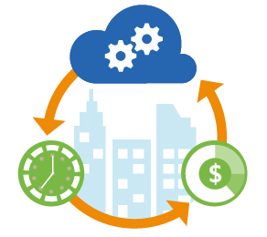
Azure DevOps for Advanced Analytics
Deployment
Tooling
Facilities and Regions
Resource Grouping
Safety
Auditing and Reporting
Troubleshooting
Service creation and setup
Account security
Cost management
Monitoring and Management
Development
Automation
Options
Optimization
Regulatory requirements
Dev/Test/Production
Groups for monitoring and billing
Redundancy
Recovery strategies
Outage fallbacks
Issue identification
Resolution call tree
Telemetry data collection and storage
Report distribution
Automated alerts
Networking and Hybrid
Support
Scheduling
Migration
Notes:
Deployment
Service Creation and Setup - https://azure.microsoft.com/en-us/offers/ms-azr-0003p/
Authentication and Access - https://docs.microsoft.com/en-us/azure/active-directory/connect/active-directory-aadconnect
Security best practices - https://docs.microsoft.com/en-us/azure/active-directory/role-based-access-control-configure
Cost Management (Pricing) - https://azure.microsoft.com/en-us/pricing/
Migrations - https://msdn.microsoft.com/en-us/library/dn727097.aspx
Tools
The Azure Portal - https://docs.microsoft.com/en-us/azure/azure-portal-overview
PowerShell - https://docs.microsoft.com/en-us/powershell/azure/overview?view=azurermps-3.8.0
CLI - https://docs.microsoft.com/en-us/cli/azure/install-azure-cli
Others - Visual Studio, System Center, Jenkins, chef
Azure Automation - https://azure.microsoft.com/en-us/services/automation/
Facilities and Regions
Locations - https://azure.microsoft.com/en-us/regions/
Azure Trust Center - https://azure.microsoft.com/en-us/support/trust-center/
Resource Grouping
Resource Groups - https://docs.microsoft.com/en-us/azure/azure-resource-manager/resource-group-overview
Using the ARM model - https://docs.microsoft.com/en-us/azure/azure-resource-manager/resource-group-template-deploy-portal
Safety - https://docs.microsoft.com/en-us/azure/storage/storage-redundancy
Auditing - https://msdn.microsoft.com/en-us/library/mt662411.aspx?f=255&MSPPError=-2147217396
Troubleshooting and Support - https://azure.microsoft.com/en-us/blog/understanding-azure-troubleshooting-and-support/
Special considerations for Advanced Analytics:
Account management
Storage and redundancy
Privacy and data protection
Scheduling and Pipelined workflows
Networking
Optimization
Security
Advanced Analytics Services awareness – data transfer, storage and processing
Dependencies and interactions

Slide 10
The R Programming Environment
Notes:
Video Introduction to R - https://mran.revolutionanalytics.com/documents/what-is-r/

Slide 11

R Programing and Environment
Open Source “lingua franca”
Global Community
Ecosystem
Can be Scaled to Big Data,
Big Analytics
Analytics, Computing, Modeling
Millions of users
7000+ Algorithms, Test Data & Evaluations
Scalability
Notes:
R In Youtube - https://www.youtube.com/user/thelearnr
R Links - http://www.datasciencecentral.com/m/discussion?id=6448529%3ATopic%3A280135
R resources - https://msdn.microsoft.com/en-us/microsoft-r/microsoft-r-more-resources

Slide 12
SQL
SQL and R Contrasted
R
Client/Server
Database Objects
DML, DDL
DCL
Declarative Code
Interactive Environment
Data Structures
Functions
Libraries (Packages)
Functional Code Flow
Notes:
Learn SQL - http://www.w3schools.com/SQl/default.asp
Try R, with a great interface - http://tryr.codeschool.com/levels/1/challenges/22
R and Statistics Intro - https://www.youtube.com/watch?v=xb5P5xdcr2U&feature=youtu.be&a
R Online - http://www.tutorialspoint.com/r_terminal_online.php
Using R to explore data - http://www.analyticsvidhya.com/blog/2015/10/cheatsheet-11-steps-data-exploration-with-codes/
Quick R Intro - http://www.datasciencecentral.com/m/blogpost?id=6448529%3ABlogPost%3A112754
Creating a recommender engine in R – http://www.analyticbridge.com/profiles/blogs/build-basic-recommendation-engine-using-r
Visualizations cheat-sheet in R - http://www.datasciencecentral.com/forum/topics/cheat-sheet-data-visualization-with-r?groupUrl=tutorials
Data Science Blog - https://buckwoody.wordpress.com/

Slide 13
R Data Types
Numeric
Integer
Complex
Logical
Character
Notes:
Video Introduction to R - https://mran.revolutionanalytics.com/documents/what-is-r/
Working with R Data Types - https://msdn.microsoft.com/en-us/library/mt590948.aspx
Data Science Blog - https://buckwoody.wordpress.com/

Slide 14
R Data Structures
Vector
A single-line sequence of one datatype
List
An ordered collection of objects, allowing a variety of (possibly unrelated) objects under one name
Matrix
A multi-line sequence of the same length and datatype
Array
Like a Matrix, but with more dimensions
Dataframe
Table-like structure
Notes:
R Data Structures from Advanced R by Hadley Wickham - http://adv-r.had.co.nz/Data-structures.html
Factors - https://www.tutorialspoint.com/r/r_factors.htm
Data Science Blog - https://buckwoody.wordpress.com/

Slide 15
Lab:
Account Activation/ VM Setup
R Tutorial
SQL Tutorial
Notes:
If you are not using a local installation of SQL Server and R, Use an Azure Account. (go here for a free account - https://azure.microsoft.com/en-us/free/ You will need a credit card, but you will not be charged)
Log in to the Azure Portal -https://ms.portal.azure.com
Click the + sign , and type Data Science Virtual Machine to create a new Windows Data Science Virtual Machine (use at least 2 Processors, around 6GB of RAM, and use HDD not SSD – larger systems will perform faster but will cost more per hour) -https://azure.microsoft.com/en-us/documentation/articles/machine-learning-data-science-vm-do-ten-things/
Pick from one of the following options:
If you are new to R:
Option 1: Open R, and then type install.packages("swirl"). Then type swirl()
Option 2: If you are new to R, open this site and complete the lessons the instructor assigns -http://tryr.codeschool.com/
If you are new to SQL, open this site and complete the lessons the instructor assigns -http://www.w3schools.com/SQl/default.asp
If you already know R and SQL, using headsets, start this series - https://www.datacamp.com/community/open-courses/big-data-revolution-r-enterprise-tutorial

Slide 16
The Microsoft R Platform
Notes:
Primary Microsoft R Site - https://msdn.microsoft.com/en-us/microsoft-r/index

Slide 17
Microsoft R Products
Microsoft R Open
Microsoft R Server
Free and open source R distribution
Built in Advanced Analytics and Stand Alone Server Capability
Enhanced and distributed by Revolution Analytics
Python and Microsoft R
Microsoft R Server for Redhat Linux
Microsoft R Server for SUSE Linux
Microsoft R Server for Teradata DB
Microsoft R Server for Hadoop on Redhat
SQL Server ML Services
Notes:
Microsoft Machine Learning Services - https://docs.microsoft.com/en-us/sql/advanced-analytics/r/r-services

Slide 18

Microsoft R Open
Enhanced Open Source R distribution
Based on the latest Open Source R
Built, tested and distributed by Microsoft
Enhanced by Intel MKL Library to speed up linear algebra functions
Compatible with all R-related software
CRAN packages, RStudio, third-party R integrations, …
Revolutions Open-Source R packages
Reproducible R Toolkit – checkpoint
MRAN website mran.revolutionanalytics.com
Enhanced documentation and learning resources
Discover 7500 free add-on R packages
Open source (GPLv2 license) - 100% free to download, use and share
Notes:
Quick Video on R Client - https://channel9.msdn.com/blogs/MicrosoftR/Microsoft-Introduces-new-free-Microsoft-R-Client

Slide 19
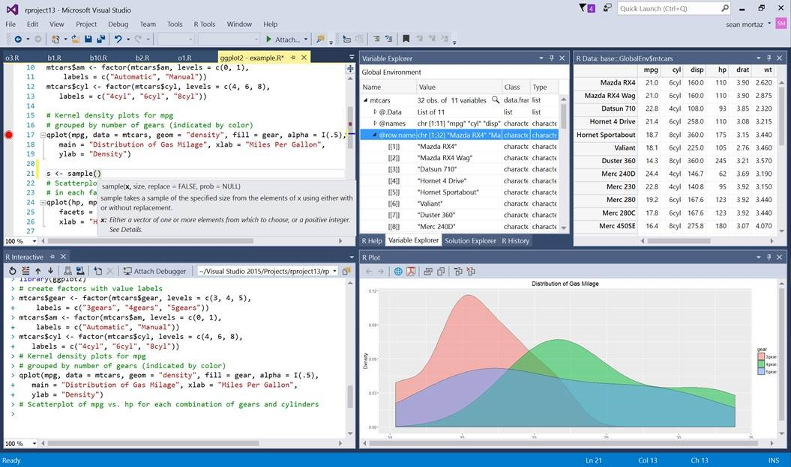
Microsoft R Open and R Client
Microsoft R Server
ScaleR
Notes:
Book and Series - http://dacrook.com/introduction-to-microsoft-r-open/
Microsoft R Client - https://msdn.microsoft.com/en-us/microsoft-r/index#mrc
Data Science Blog - https://buckwoody.wordpress.com/

Slide 20
Microsoft R Components
Microsoft R Open
Microsoft R Client
Microsoft R Server
HDInsight SparkR / SQL Server ML Services
R Module in Azure Machine Learning
Notes:
Supported Platforms for Microsoft R Server - https://msdn.microsoft.com/en-us/microsoft-r/rserver-install-supported-platforms
Book and Series – http://dacrook.com/introduction-to-microsoft-r-open/
Microsoft R Client - https://msdn.microsoft.com/en-us/microsoft-r/index#mrc
Microsoft R Server - https://msdn.microsoft.com/en-us/microsoft-r/index#mrs
SQL Server R Services -https://msdn.microsoft.com/en-us/microsoft-r/index#sqlr
HDInsight SparkR -https://azure.microsoft.com/en-gb/services/hdinsight/apache-spark/
Data Science Blog - https://buckwoody.wordpress.com/

Slide 21
Microsoft R Server
Microsoft R Server is a broadly deployable enterprise-class analytics platform based on R that is supported, scalable and secure. Supporting a variety of big data statistics, predictive modeling and machine learning capabilities, R Server supports the full range of analytics – exploration, analysis, visualization and modeling
DeployR
High-performance open source R plus:
Data source connectivity to big-data objects
Big-data advanced analytics
Multi-platform environment support
Inpredictive modeling
Development and production environment support
IDE for data scientist developers
Secure, Scalable R Deployment
R Open
R Server
ConnectR
R+CRAN
RSR Connector
ScaleR
DistributedR
Open Source Components
Licensed Components
Notes:
Microsoft ML Server - https://msdn.microsoft.com/en-us/microsoft-r/index#mrs

Slide 22

CRAN, MRO, R Comparison
Microsoft
R Open
Microsoft
R Server
Datasize | In-memory | In-memory | In-Memory or Disk Based
Speed of Analysis | Single threaded | Multi-threaded | Multi-threaded, parallel processing 1:N servers
Support | Community | Community | Community + Commercial
Analytic Breadth & Depth | 7500+ innovative analytic packages | 7500+ innovative analytic packages | 7500+ innovative packages + commercial parallel high-speed functions
License | Open Source | Open Source | Commercial license. Supported release with indemnity
Notes:
Technology Overview -https://channel9.msdn.com/Series/Microsoft-R-Server/Technology-Overview-for-Microsoft-R-Server-2016

Slide 23

CRAN R
MRO
R Server
Adds multithreaded computation for linear algebra
MRS Packages
doRSR
RevoIOQ
RevoMods
RevoPemaR
RevoRpeConnector
RevoRsrConnector
RevoScaleR
RevoTreeView
RevoUtils
Adds functions and infrastructure for scalable computation over local and distributed platforms
Makes it easy to share R code and replicate results using specific R package versions.
MRO Packages
checkpoint (also on CRAN)
RevoUtilsMath (for MKL)
MRO Packages
checkpoint (also on CRAN)
RevoUtilsMath (for MKL)
Standard Packages
base
recommended
Standard Packages
base
recommended
Standard Packages
base
recommended
BLAS / LAPACK - Standard
BLAS / LAPACK – Intel MKL
BLAS / LAPACK – Intel MKL
Kernel
Kernel
Kernel
Notes:
Getting Started - https://msdn.microsoft.com/en-us/microsoft-r/?f=255&MSPPError=-2147217396

Slide 24
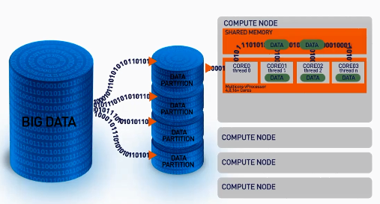
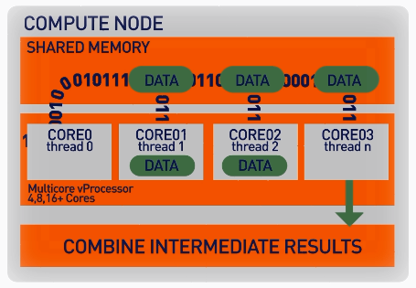
ScaleR – Parallel + “Big Data”
ScaleR algorithms work inside multiple cores / nodes in parallel at high speed
Stream data in to RAM in blocks. “Big Data” can be any data size. Handle Megabytes to Gigabytes to Terabytes…
Interim results are collected and combined analytically to produce the output on the entire data set
XDF file format is optimised to work with the ScaleR library and significantly speeds up iterative algorithm processing.
Notes:
Function Breakdown - https://msdn.microsoft.com/en-us/microsoft-r/scaler/scaler

Slide 25

Scale R – Parallelized Algorithms & Functions
Data Preparation
Statistical Tests
Variable Selection
Data import – Delimited, Fixed, SAS, SPSS, OBDC
Variable creation & transformation
Recode variables
Factor variables
Missing value handling
Sort, Merge, Split
Aggregate by category (means, sums)
Chi Square Test
Kendall Rank Correlation
Fisher’s Exact Test
Student’s t-Test
Stepwise Regression
Simulation
Sampling
Simulation (e.g. Monte Carlo)
Parallel Random Number Generation
Subsample (observations & variables)
Random Sampling
Cluster Analysis
Descriptive Statistics
Predictive Models
Min / Max, Mean, Median (approx.)
Quantiles (approx.)
Standard Deviation
Variance
Correlation
Covariance
Sum of Squares (cross product matrix for set variables)
Pairwise Cross tabs
Risk Ratio & Odds Ratio
Cross-Tabulation of Data (standard tables & long form)
Marginal Summaries of Cross Tabulations
K-Means
Sum of Squares (cross product matrix for set variables)
Multiple Linear Regression
Generalized Linear Models (GLM) exponential family distributions: binomial, Gaussian, inverse Gaussian, Poisson, Tweedie. Standard link functions: cauchit, identity, log, logit, probit. User defined distributions & link functions.
Covariance & Correlation Matrices
Logistic Regression
Classification & Regression Trees
Predictions/scoring for models
Residuals for all models
Classification
Decision Trees
Decision Forests
Gradient Boosted Decision Trees
Naïve Bayes
Combination
rxDataStep
rxExec
PEMA-R API Custom Algorithms
Notes:
SQL Server Implementation of ScaleR Functions - https://msdn.microsoft.com/en-us/library/mt652103.aspx

Slide 26
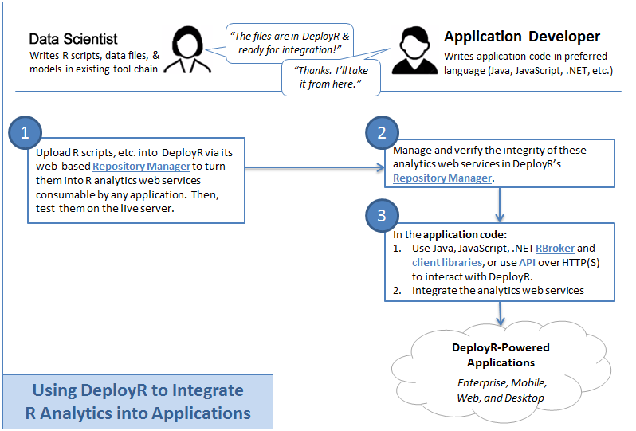
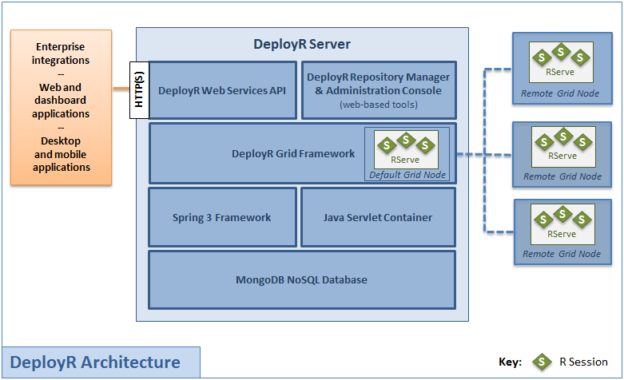
DeployR
Notes:
Microsoft DeployR Documentation - https://msdn.microsoft.com/en-us/microsoft-r/deployr-about
Previous Documentation - https://deployr.revolutionanalytics.com/documents/getting-started/about/
Data Science Blog - https://buckwoody.wordpress.com/

Slide 27
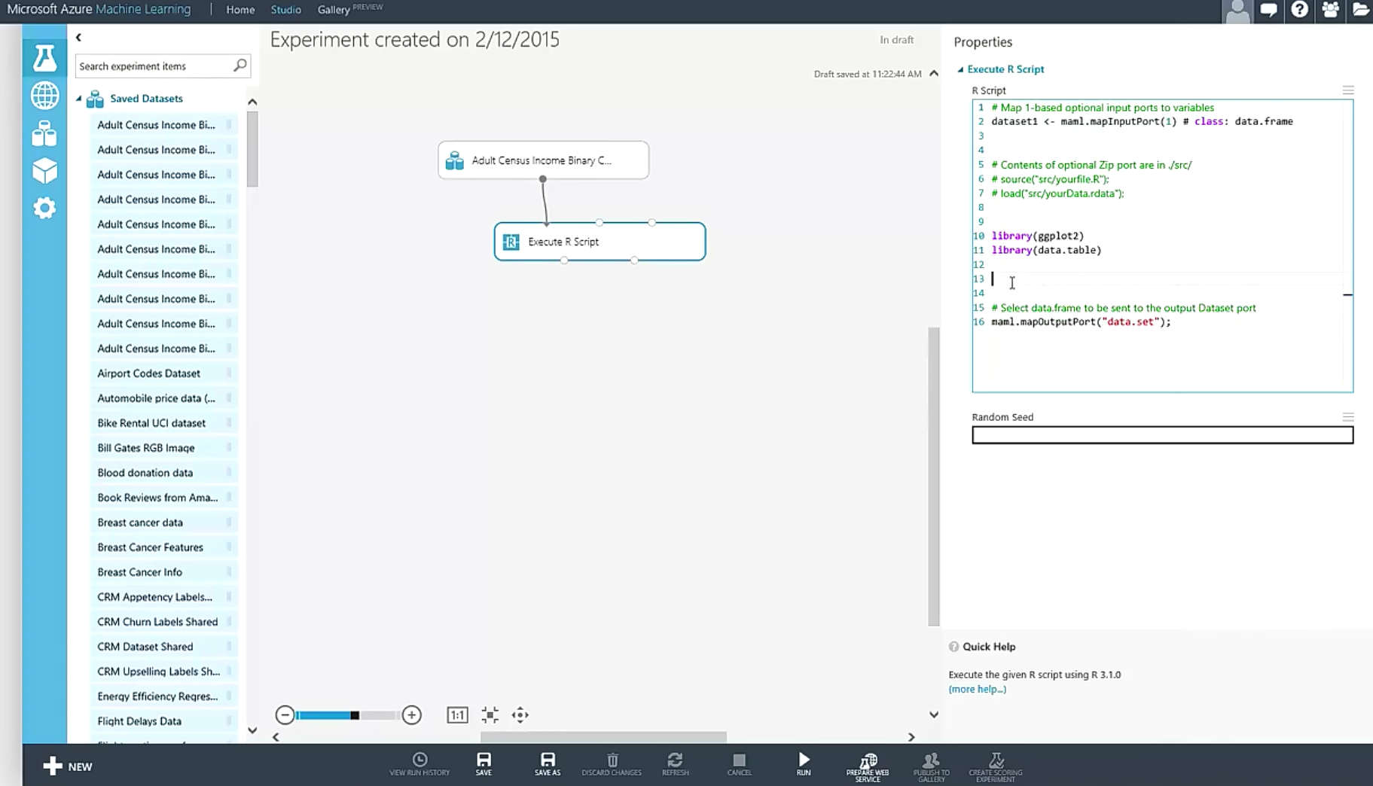
R Module in Azure Machine Learning
Dataset1 <-maml.mapInputPort(1) # class:data.frame
Notes:
Primary reference - https://msdn.microsoft.com/en-us/library/dn905952.aspx
Using R in Azure Machine Learning - https://azure.microsoft.com/en-us/documentation/articles/machine-learning-r-quickstart/
Overview Video - https://channel9.msdn.com/Blogs/Windows-Azure/R-in-Azure-ML-Studio
R Packages supported - https://msdn.microsoft.com/en-us/library/mt741980.aspx
Data Science Blog - https://buckwoody.wordpress.com/

Slide 28
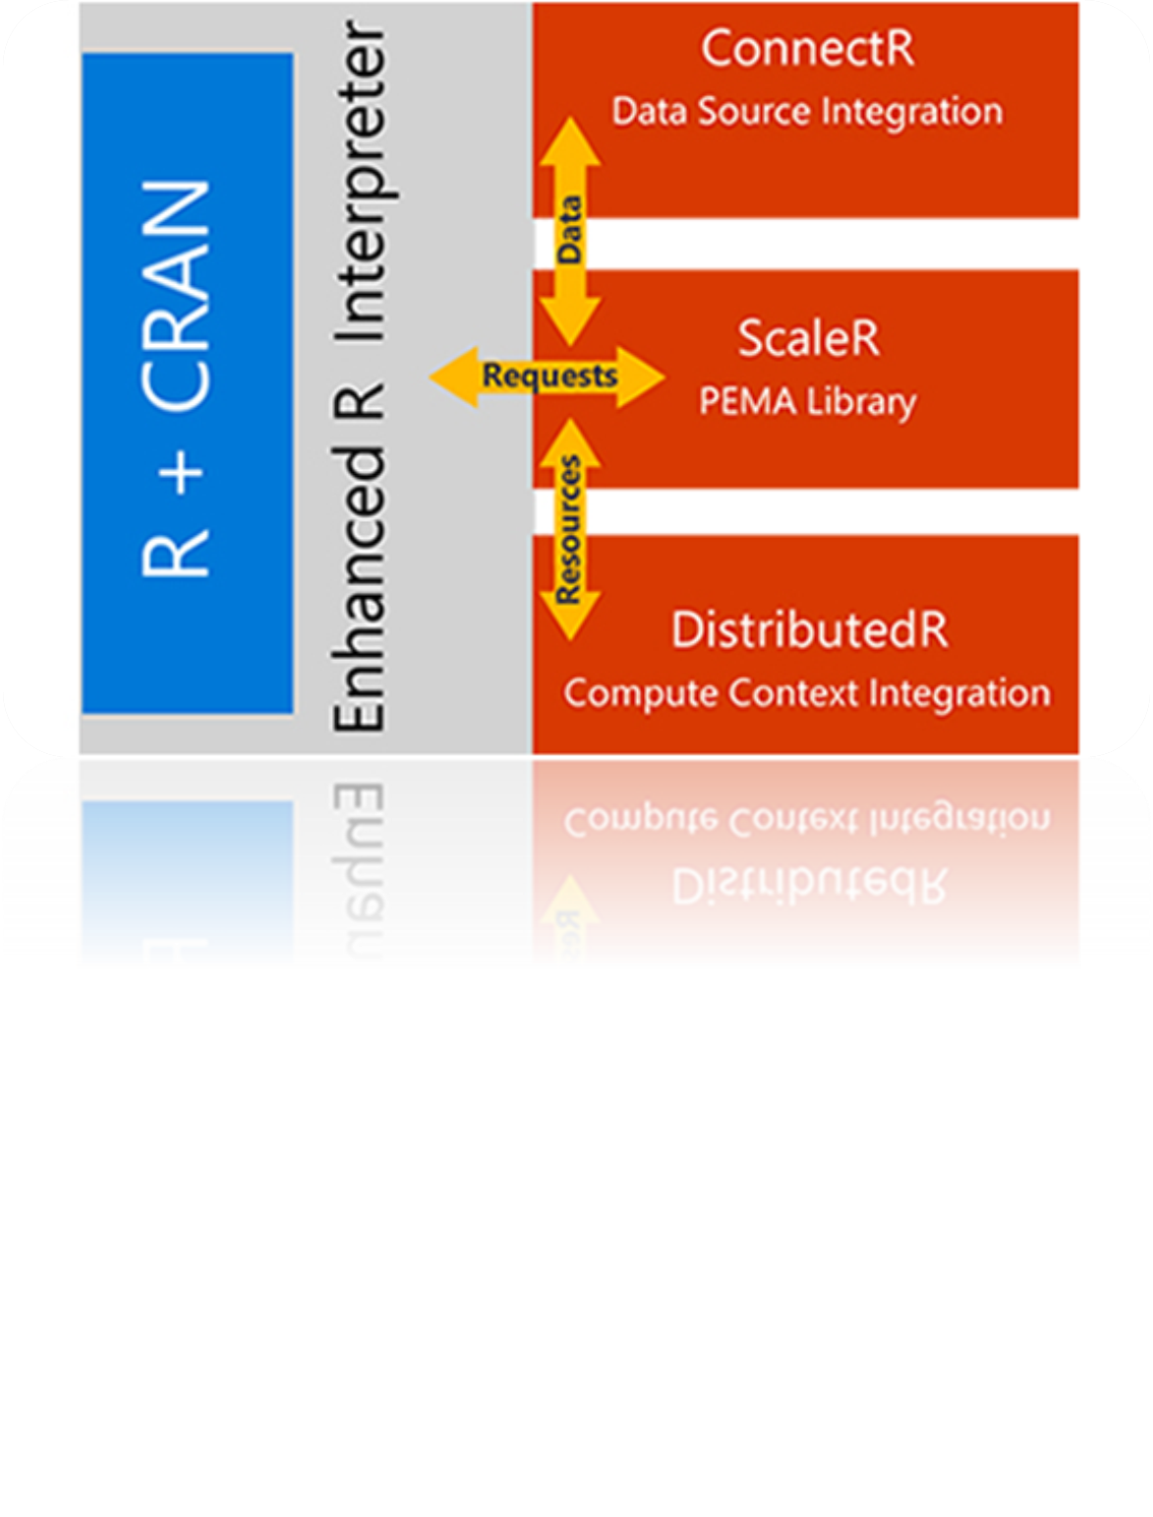
R in Spark HDInsight Cluster
Core Hadoop
Data processing
Microsoft integration
Data Movement
Packages
Pipeline / workflow
(Oozie)
JavaScript
C#, F#, .NET
(Zoo)
SparkR
Data Integration
(ODBC / SQOOP/ REST)
Relational
(SQL Server)
Metadata
(HCatalog)
PDW Polybase
Real Time Processing (Storm)
NoSQL Database
(HBase)
Scripting
(Pig)
Query
(Hive)
Event Driven Processing
Distributed Processing
(MapReduce)
Event Pipeline
(Event Hub/ Flume)
Business Intelligence
(Excel, Power View, SSAS)
YARN
Distributed Storage (HDFS)
Monitoring & Deployment (System Center)
World's Data (Azure Data Marketplace)
Azure Storage Vault (ASV)
Active Directory (Security)
Notes:
Full training example for the local HDP Instance - http://hortonworks.com/hadoop-tutorial/hello-world-an-introduction-to-hadoop-hcatalog-hive-and-pig/
More detail on the Hadoop Components -http://www.datasciencecentral.com/profiles/blogs/hadoop-herd-when-to-use-what

Slide 29

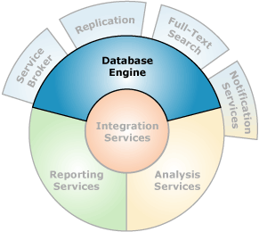
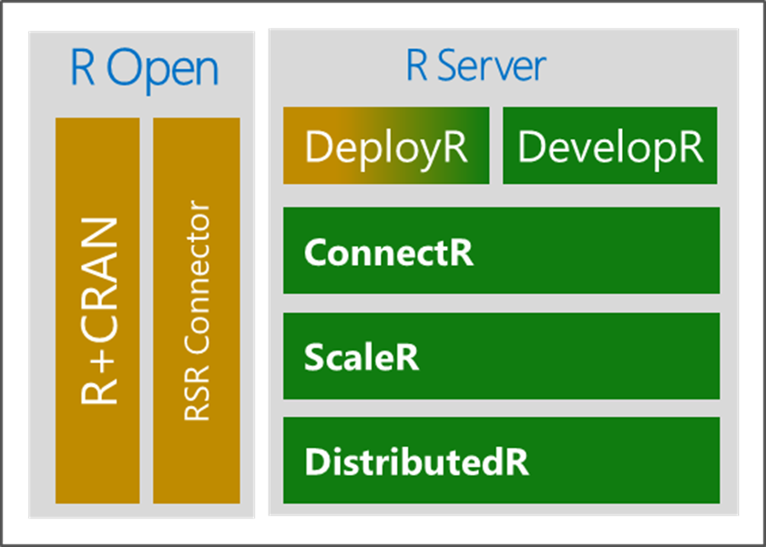

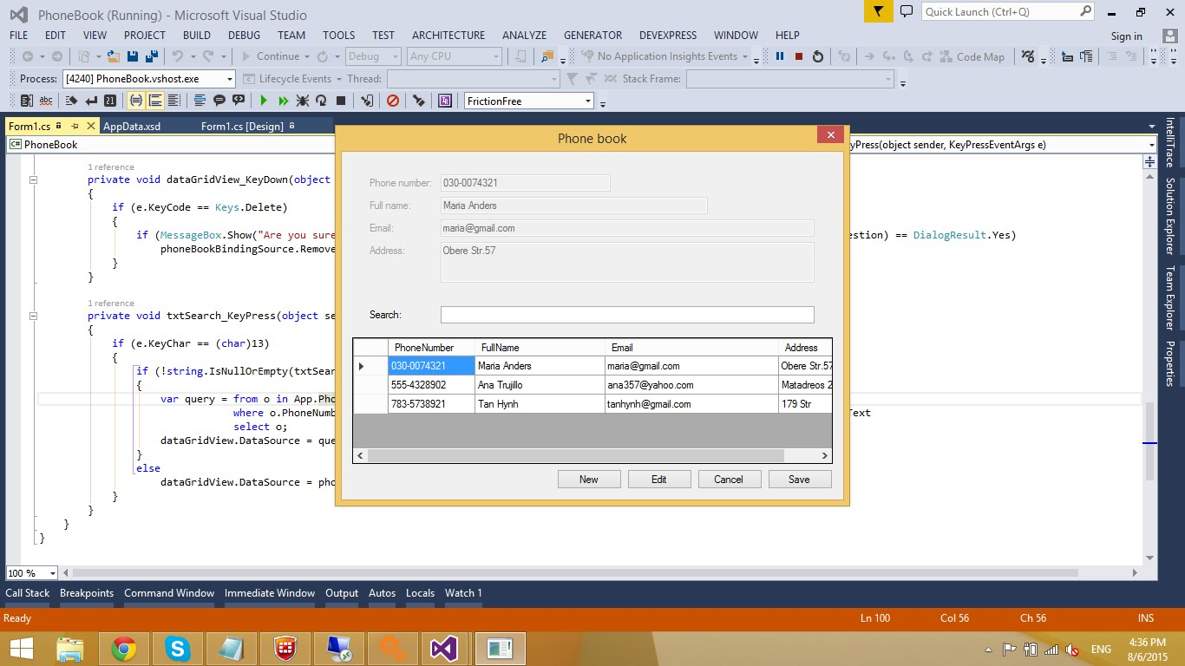
Microsoft ML Services in SQL Server
Microsoft R Server
Launchpad
(BxlServer and SQL Satellite, Rserver.dll)
Notes:
Primary Documentation and training -https://msdn.microsoft.com/en-us/library/mt604845.aspx
Great set of resources - https://www.r-bloggers.com/r-and-sql-server-articles/amp/
Data Science Blog - https://buckwoody.wordpress.com/

Slide 30
Lab:
Install and Configure R Environments
Notes:
Read the installation page for ML Server – https://msdn.microsoft.com/en-us/microsoft-r/rserver-install-supported-platforms
As assigned: Install Microsoft R Client - https://msdn.microsoft.com/en-us/microsoft-r/install-r-client-windows
As assigned: Install MRS on Windows -https://msdn.microsoft.com/en-us/microsoft-r/rserver-install-windows?f=255&MSPPError=-2147217396
As assigned: Install ML Server on Linux – note: MSDN account required -https://msdn.microsoft.com/en-us/microsoft-r/rserver-install-linux-server?f=255&MSPPError=-2147217396
As assigned: Install SQL Server and ensure you select ML Services – see this link -https://www.microsoft.com/en-us/cloud-platform/sql-server-editions-developers
Find out if R is loaded: - Open an R Client Session (SQL, MRS, AML, etc) and run sessionInfo()

Slide 31
R Client Options
Notes:
The Microsoft R Client -https://msdn.microsoft.com/en-us/microsoft-r/install-r-client-windows

Slide 32
Microsoft R Development Tools
Command-Line
RStudio
R Tools for Visual Studio (RTVS)
SQL Server tools
Notes:
Installing Microsoft R Client on Windows -https://msdn.microsoft.com/en-us/microsoft-r/install-r-client-windows
Files located at: C:\Program Files\Microsoft\R Client\R_SERVER\bin
Data Science Blog - https://buckwoody.wordpress.com/

Slide 33
Lab:
Install and Configure Client Environments
Install and Configure R Environments
Notes:
Connect to R in Visual Studio or Rstudio or Command line (C:\Program Files\Microsoft SQL Server\MSSQL13.MSSQLSERVER\R_SERVICES\bin>R.exe) , and Run Revo.version to ascertain MRS running
Open Visual Studio, and read through the walkthrough of the RTVS tools for SQL Server and R - https://microsoft.github.io/RTVS-docs/sqlserver.html

Slide 34
Operationalize R
Notes:
Complete introduction -https://msdn.microsoft.com/en-us/microsoft-r/microsoft-r-getting-started
Data Exploration and Modeling with R -https://msdn.microsoft.com/en-us/library/mt590947.aspx

Slide 35
Configuration and Operation
Planning
Specific Environments
File Locations
Services and Background Processes
Package Management
DeployR Planning
Notes:
Setting up R Services - https://msdn.microsoft.com/en-us/library/mt696069.aspx
Features and Tasks - https://msdn.microsoft.com/en-us/library/mt590811.aspx
Differences in Features - https://msdn.microsoft.com/en-us/library/mt721284.aspx
Installing on VM’s - https://msdn.microsoft.com/en-us/library/mt748179.aspx

Slide 36
Distributed R - Write once, deploy multiple
+ HD Insights
+ Hadoop Spark
Hortonworks
Cloudera
MapR
Hadoop
EDW
Teradata
ConnectR
+ SQL Server v16
Microsoft R Server
DeployR
DevelopR
R+CRAN
RSR Connector
ScaleR
Workstations & Servers
Linux Windows
DistributedR
In the Cloud
Azure Marketplace
+ Azure ML
Code Portability Across Platforms
Notes:
DeployR Workflow - https://msdn.microsoft.com/en-us/microsoft-r/deployr-about

Slide 37
CRAN/Microsoft R Open And Databases
RODBC
Notes:
Book and Series - http://dacrook.com/introduction-to-microsoft-r-open/
Microsoft R Client - https://msdn.microsoft.com/en-us/microsoft-r/index#mrc
Data Science Blog - https://buckwoody.wordpress.com/

Slide 38
Microsoft ML Services in SQL Server
Microsoft R Server
Launchpad
(BxlServer and SQL Satellite, Rserver.dll)
Notes:
Primary Documentation and training -https://msdn.microsoft.com/en-us/library/mt604845.aspx
Data Science Blog - https://buckwoody.wordpress.com/

Slide 39
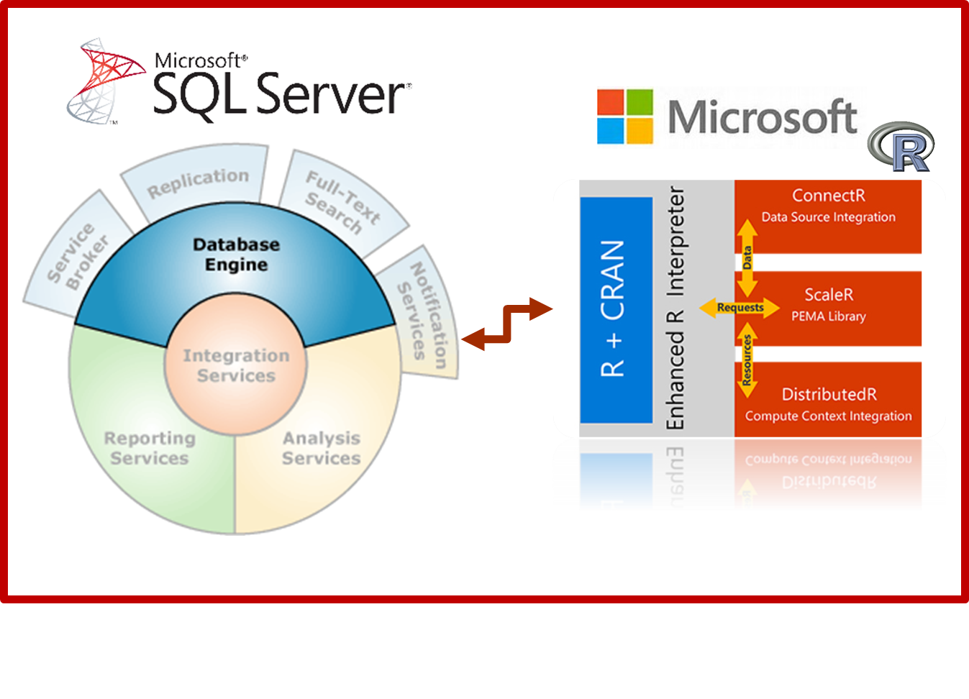
T-SQL and R Interaction
EXEC sp_execute_external_script
@language =N'R',
-- SQL Part (sends to @script)
@input_data_1 =N 'SELECT 1 as Installed',
-- R Part (gets @input_data_1)
@script=N'OutputDataSet<-InputDataSet'
WITH RESULT SETS
(([Installed] int not null));
GO
Notes:
Components and Architecture - https://msdn.microsoft.com/en-us/library/mt709082.aspx (with graphics)

Slide 40
Lab:
Check/Enable R Services in SQL Server
Lab:
Notes:
From the Resources folder open the file R Services for SQL Server Lab.sql and run the section marked:
/* Check to see if R is Installed and available */

Slide 41
T-SQL and R Interaction
T-SQL Code
SELECT data
sp_execute_external_script
Launchpad (BxlServer and SQL Satellite, Rserver.dll)
R Data or Object Returns
Notes:
Components and Architecture - https://msdn.microsoft.com/en-us/library/mt709082.aspx (with graphics)

Slide 42
Lab:
Run R and T-SQL in SQL Server
Lab:
Notes:
Open this link and complete the assignments (1-3) from the instructor - https://docs.microsoft.com/en-us/sql/advanced-analytics/tutorials/rtsql-using-r-code-in-transact-sql-quickstart

Slide 43
Performance and Monitoring
Performance considerations
Monitoring
Tuning
Notes:
Extended Events for SQL Server R Services - https://msdn.microsoft.com/en-us/library/mt628054.aspx

Slide 44
Lab:
Lab:
Monitoring and Performance Tuning
Notes:
Open this link and create the custom reports for SSMS - https://docs.microsoft.com/en-us/sql/advanced-analytics/r/monitor-r-services-using-custom-reports-in-management-studio
Open this link and complete the assignments from the instructor - https://docs.microsoft.com/en-us/sql/advanced-analytics/r/how-to-create-a-resource-pool-for-r

Slide 45
Security and Governance
Principals
Securables
Notes:
Security Overview - https://msdn.microsoft.com/en-us/library/mt709078.aspx

Slide 46
Lab:
Security and R Services for T-SQL
Lab:
Notes:
Review and bookmark this link - https://docs.microsoft.com/en-us/sql/advanced-analytics/r/security-considerations-for-the-r-runtime-in-sql-server
Open a command-prompt on your server and type NET USERS (Enter). Review the accounts you see there.

Slide 47
Packages
Use
Adding
Querying
Considerations
Notes:
Packages - http://www.dummies.com/programming/r/how-to-install-load-and-unload-packages-in-r/ and https://cran.r-project.org/doc/manuals/R-admin.html#Add_002don-packages
Book on Creating your own Packages - http://r-pkgs.had.co.nz/
A useful set of packages -https://support.rstudio.com/hc/en-us/articles/201057987-Quick-list-of-useful-R-packages
R Packages supported by Azure Machine Learning -https://msdn.microsoft.com/en-us/library/mt741980.aspx
R Package Management for SQL Server R Services -https://msdn.microsoft.com/en-us/library/mt790486.aspx
Scaling Packages - https://msdn.microsoft.com/en-US/library/mt637368.aspx
Data Science Blog - https://buckwoody.wordpress.com/

Slide 48
Lab:
Package Management in R and T-SQL
Lab:
Notes:
Open this link and review - https://docs.microsoft.com/en-us/sql/advanced-analytics/r/r-package-management-for-sql-server-r-services
Install the ggplot2 package on your server

Slide 49
Implementation Considerations
Coordinating with the R professional
Best Practices
Notes:
Managing and monitoring R Solutions for SQL Server -https://msdn.microsoft.com/en-us/library/mt590866.aspx
Upgrade and Installation -https://msdn.microsoft.com/en-us/library/mt653951.aspx
Considerations -https://msdn.microsoft.com/en-us/library/mt590540.aspx

Slide 50
Creating a Microsoft R Solution
https://mva.microsoft.com/ebooks/
Notes:
Complete introduction - https://msdn.microsoft.com/en-us/microsoft-r/microsoft-r-getting-started

Slide 51
Lab:
SQL Server R Services Comprehensive Lab
Lab:
Notes:
Optional - https://docs.microsoft.com/en-us/sql/advanced-analytics/tutorials/sqldev-in-database-advanced-analytics-for-sql-developers
Optional - https://docs.microsoft.com/en-us/sql/advanced-analytics/tutorials/walkthrough-data-science-end-to-end-walkthrough
Optional -https://gallery.cortanaintelligence.com/Tutorial/Predictive-Maintenance-Template-with-SQL-Server-R-Services-1
Channel 9 Video on examples -https://channel9.msdn.com/Shows/Cloud+Cover/Episode-226-Microsoft-R-Server-Solutions
More labs - https://github.com/Microsoft/SQL-Server-R-Services-Samples and https://gallery.cortanaintelligence.com/Collection/ML-Templates-with-SQL-Server-R-Services-1

Slide 52
Understand the R Language and where it is used
Understand the Microsoft R Platform and its capabilities
Set up and use the server and various client tools for a R environment
Know how to operationalize a SQL Server R Services environment
Use the Microsoft R capabilities in a solution
Notes:
Questions?
More resources:
https://msdn.microsoft.com/en-us/microsoft-r/microsoft-r-more-resources
Revolutions Blog
Microsoft R and SQL Server - https://www.r-bloggers.com/r-and-sql-server-articles/amp/
Blog: Joseph Sirosh, “Making R the Enterprise Standard…”
Getting Started with Microsoft R
Diving In.. Data Analysis in Microsoft R
R Server Technology – Video
R Tools for Visual Studio Sneak Peek
R Tools for Visual Studio Overview
SQL R Services Overview – Youtube
SQL R Services Feature Overview - Youtube
SQL R Services Overview at Build
SQL R Services Tutorial

